Slide 1
PPL Section 2 part 2

Slide 2
Principles of Programming Languages (MCT542 )
Computer Application Department,
RCOEM

Slide 3
Syllabus (MCA SEM- V)
Course Code: MCT542
Courses: Principles of Programming Languages
L:3 Hrs, P: 0 Hrs, Per week
Total Credits: 3

Slide 4
Data Types
Data Types, Numeric types, Implementations of int, float, bool, char, enum, subranges, Type equivalence, type conversion, coercion, type safety, Records, packed and unpacked implementations, Variant Records, Arrays, Row major allocation, Address calculation, Row/Column major allocation method impact, Row-pointer layout, Address calculation of row-pointer layout, Generation of code for array access, Stack Smashing due to lack of bound checks, Pointers, Recursive Data types, Tombstones/Lock and Key for Dangling Reference.

Slide 5
Data Types
Introduction
A data type defines a collection of data objects and a set of predefined operations on those objects.
A descriptor is the collection of the attributes of a variable . (meta data in DBMS)
An object represents an instance of a user-defined (abstract data) type.
One design issue for all data types: What operations are defined and how are they specified?

Slide 6
Types
Types play a central role in the design and implementation of programming languages.
We can think of a type as a set of properties associated with a data value.
Most, but not all, programming languages associate types with values.
The data type of a variable determines the values the variable may contain along with the operations that may be performed on it.
A programming language may have predefined basic data types and rules for defining additional types.

Slide 7
Types
ANSI C includes char, a variety of integers and floating point numbers, enumerations, and void as its basic data types. Derived types that can be constructed from other types in a variety of ways include:
arrays of objects of a given type
functions returning objects of a given type
pointers to objects of a given type
structures containing a sequence of objects of various types
unions capable of containing any one of several objects of various types

Slide 8
Data Types
Types serve two principal purposes:
Types often provide an implicit context for operations (result of operation) in a program. For example , in a C program the operation + in the expression x+y will be integer if x and y are int , and floating –point addition if x and y are of type float.
Types are very useful for catching programming errors by making sure operators are applied to semantically valid operands. A strong argument for statically checkable types is that type clashes can be reported to the programmer at compile time. For example, a Java compiler can report an error at compile time if x and y are known to be of type Stirng in the expression x *y.

Slide 9
Implementation of elementary data types
Storage Representation for data objects
Hardware Influence
Software Influence
Value of that type
Compiler
Descriptor
Set of algorithms or procedures that define the operations of the type in terms of manipulations of the storage representation
Directly as a hardware operation
As a subprogram or procedure
As an inline code sequence
E.g abs(x)=if x<0 then –x else x

Slide 10
Data Types
Numeric Types
A few languages (e.g., C and Fortran) distinguish between different lengths of integers and real numbers;
Unfortunately, differences in precision across language implementations lead to a lack of portability: programs that run correctly on one system may produce run-time errors or erroneous results on another.
A few languages, including C, C++, C# and Modula-2, provide both signed and unsigned integers (Modula-2 calls unsigned integers cardinals).

Slide 11
Data Types
A few languages (e.g., Fortran, C99, Common Lisp, and Scheme) provide a built-in complex type, usually implemented as a pair of floating-point numbers that represent the real and imaginary Cartesian coordinates.
A few languages (e.g., Scheme and Common Lisp) provide a built-in rational type, usually implemented as a pair of integers that represent the numerator and denominator.

Slide 12
Data Types
discrete types or ordinal type:
Integers, Booleans, and characters are all examples of discrete types (also called ordinal types): the domains to which they correspond are countable (they have a one-to-one correspondence with some subset of the integers), and have a well defined notion of predecessor and successor for each element other than the first and the last.
Two varieties of user-defined types, enumerations and subranges, are also discrete.
Discrete, rational, real, and complex types together constitute the scalar types. Scalar types are also sometimes called simple types.

Slide 13
Data Types
Enumeration Types
Enumerations were introduced by Wirth in the design of Pascal.
An enumeration type consists of a set of named elements
In Pascal, one can write:
type weekday = (sun, mon, tue, wed, thu, fri, sat);
The values of an enumeration type are ordered, so comparisons are generally valid (mon < tue), and there is usually a mechanism to determine the predecessor or successor of an enumeration value (in Pascal, tomorrow := succ(today)).
The ordered nature of enumerations facilitates the writing of enumeration-controlled
loops:
for today := mon to fri do begin ...

Slide 14
Data Types
It also allows enumerations to be used to index arrays:
var daily_attendance : array [weekday] of integer;

Slide 15
Data Types
Several languages allow the programmer to specify the ordinal values of enumeration types, if the default assignment is undesirable. In C, C++, and C#, one could write
enum mips_special_regs {gp = 28, fp = 30, sp = 29, ra = 31};

Slide 16
Data Types
SubrangeTypes
First introduced in Pascal, and are found in many subsequent languages
A subrange is a type whose values compose a contiguous subset of the values of some discrete base type (also called the parent type)
In Pascal, subranges look like this:
type test_score = 0..100;
workday = mon..fri;
In Ada one would write
type test_score is new integer range 0..100;
subtype workday is weekday range mon..fri;

Slide 17
Data Types
type test_score is new integer range 0..100;
subtype workday is weekday range mon..fri;
The range... portion of the definition in Ada is called a type constraint.
In this example test_score is a derived type, incompatible with integers.
The workday type, on the other hand, is a constrained subtype; workdays and weekdays can be more or less freely intermixed. The distinction between derived types and subtypes is a valuable feature of Ada;

Slide 18
Data Types
s

Slide 19
Data Types
Data Types, Numeric types, Implementations of int, float, bool, char, enum, subranges, Type equivalence, type conversion, coercion, type safety, Records, packed and unpacked implementations, Variant Records, Arrays, Row major allocation, Address calculation, Row/Column major allocation method impact, Row-pointer layout, Address calculation of row-pointer layout, Generation of code for array access, Stack Smashing due to lack of bound checks, Pointers, Recursive Data types, Tombstones/Lock and Key for Dangling Reference.

Slide 20
Component of type system
Type constructor : array , string , records (structure)
Int a[5] ; is like array(5, Interger)
Basic type : int , float, char
Int a=5, b=4;
a/b ->1

Slide 21
Type Equivalence
How we can say in c two variables have the same type , two expression have the same type?
If that two variables or expressions return the same data type then they are said to be equivalent.
E.g. type def
There are two principles ways of defining type equivalence
Structurally Equivalence
Name equivalence

Slide 22
Structurally Equivalent
They are the same basic type.
They are formed by applying the same constructor ( say array) to structurally equivalent types.
One is a type name that denote the other. (type def or alias naming).
Note : In structurally refers to same memory location memory occupying space must be same.

Slide 23
Example of structural Equivalence
Integer is structurally equivalent to integer
Type S and T are structurally equivalent if the are declared as
type S =array[0..9] of integer
type T = array[0..9] of integer
Type S and integer are structurally equivalent if S is declared as : type S= integer;

Slide 24
Name Equivalent
They are the same basic type.
They are formed by applying the same constructor ( say array) to structurally equivalent types.
E.g. char a,b;
a=‘A’;
b=a;

Slide 25
Data Types
Name Equivalence
TYPE new_type = old_type; (* Modula-2 *)
Here new_type is said to be an alias for old_type. Should we treat them as two names for the same type, or as names for two different types that happen to have the same internal structure?
A language in which aliased types are considered distinct is said to have strict name equivalence.
A language in which aliased types are considered equivalent is said to have loose name equivalence. Most Pascal-family languages (including Modula-2) use loose name equivalence.

Slide 26
Data Types
One way to think about the difference between strict and loose name equivalence is to remember the distinction between declarations and definitions
Under strict name equivalence, a declaration type A = B is considered a definition. Under loose name equivalence it is merely a declaration;

Slide 27
Data Types
If the programmer wishes to use a value of one type in a context that expects another, he or she will need to specify an explicit type conversion (also sometimes called a type cast ).
A change of type that does not alter the underlying bits is called a nonconverting type cast, or sometimes a type pun.

Slide 28
Type Conversion or Type Casting
A type cast is basically a conversion from one datatype to another datatype
Needed for avoiding data loss
Expression having more than one data type
There are two types of conversions
Implicit type conversion (type promotion)
Explicit type conversion

Slide 29
Implicit type conversion
It is a case when, a compiler converts one data type into another type of data automatically.
There is no external trigger form the user for this type of conversion.
Lower data type to higher data type
There is no data loss
For example
short a=20;
int b=a;
So short range data type is accumulated under a long range data type
Boolean-char-short int –int-float-long-double-long double.

Slide 30
void main()
{
int x=10;
char y= ‘a’;
x=x+y;
printf(“x=%d”,x)
}
Output x=107
Note ascii value of small a is 97

Slide 31
void main()
{
double x=1.2;
int sum= (int)x+1;
printf(“sum=%d”,sum)
}
Output sum=2

Slide 32
Explicit type conversion
It is a case when, data of one type is converted explicitly (forcefully) to another type, with the help of predefined function.
There is a data loss
Some conversion cannot be made implicitly.
For example
int to short
trying to convert higher data type to lower data type, there may chance of data loss.
Syntax : (type) expression
For example
(int) a ( a is any data type higher than int)

Slide 33
Data Types
Type Conversion and Casts
a := expression
we expect the right-hand side to have the same type as a. In the expression a + b the overloaded + symbol designates either integer or floating-point addition;
we therefore expect either that a and b will both be integers, or that they will both be reals.

Slide 34
Data Types
Coercion (Forcefully)
Whenever a language allows a value of one type to be used in a context that expects another, the language implementation must perform an automatic, implicit conversion to the expected type. This conversion is called a type coercion.

Slide 35
Advantage & Disadvantage of coercion
(Advantage)It basically free the programmer form the low level concerns upto some level as adding two different data types i.e. real and int.
(Disadvantage)As programmer concern to some level is reduced which may be that it hides some serious errors which will not be easy to point out afterwards.

Slide 36
Type Error
A type error is an error or undefined behavior which arises when a program attempts to perform an operation on a value on which the operation is undefined for.
For example, a programming language might allow us to treat a boolean as an integer and allow a boolean to be added to an integer. Although the result will be undefined the language raises no compile or run time errors.

Slide 37
Type Safety
The type-safety of a programming language is the extent to which it prevents type-errors.
The language can prevent a type-error at compile type or at runtime.
For example consider a 32-bit quantity in the machine. It can represent an int, a floating point or 4 ASCII characters.
Any of these interpretations may be correct given the context.
In certain programming languages (e.g. assembly), the programmer is entirely responsible of keeping track of the data types. If the programmer grabs a 32-bit number which really represents an integer and performs a machine level floating point addition on it, the result is undefined, meaning the results may be unpredictable from one computer to the next.
Higher level programming languages usually

Slide 38
Type Safety
Higher level programming languages usually reduce the burden of the programmer by keeping track of data types, by identifying type errors at compile or run-time, there-by reducing undefined behavior.
Some languages such as C/C++ define many constructs as undefined behavior, while other languages, for example Java, have less undefined behavior.
The extent to which a language provides type-error checking at compile time or runtime determines its type-safety.

Slide 39
Data Types
Type Compatibility
Most languages do not require equivalence of types in every context. Instead, they merely say that a value’s type must be compatible with that of the context in which it appears.
For Ex: In an assignment statement, the type of the right-hand side must be compatible with that of the left-hand side. The types of the operands of + must both be compatible with some common type that supports addition (integers, real numbers, or perhaps strings or sets).
In a subroutine call, the types of any arguments passed into the subroutine must be compatible with the types of the corresponding formal parameters, and the types of any formal parameters passed back to the caller must be compatible with the types of the corresponding arguments.
The definition of type compatibility varies greatly from language to language.

Slide 40
Data Types
overloading and coercion
overloading and coercion can sometimes be used to similar effect Consider the addition of numeric quantities.
In the expression a + b, + may refer to either the integer or the floating-point addition operation. In a language without coercion, a and b must either both be integer or both be real; the compiler chooses the appropriate interpretation of + depending on their type.
In a language with coercion, + refers to the floating-point addition operation if either a or b is real; otherwise it refers to the integer addition operation.

Slide 41
Data Types
Universal ReferenceTypes
For systems programming,or to facilitate thewriting of general-purpose container (collection) objects (lists, stacks, queues, sets, etc.) that hold references to other objects, several languages provide a universal reference type.
In C and C++, this type is called void *. In Clu it is called any; inModula-2, address; inModula-3, refany; inJava, Object; in C#, object.
Java and C# programmers frequently create container classes that hold objects of the universal reference class (Object or object, respectively).

Slide 42
Data Types
When an object is removed from a container, it must be assigned (with a type cast) into a variable of an appropriate class before anything interesting can be done with it

Slide 43
Data Types
Data Types, Numeric types, Implementations of int, float, bool, char, enum, subranges, Type equivalence, type conversion, coercion, type safety, Records, packed and unpacked implementations, Variant Records, Arrays, Row major allocation, Address calculation, Row/Column major allocation method impact, Row-pointer layout, Address calculation of row-pointer layout, Generation of code for array access, Stack Smashing due to lack of bound checks, Pointers, Recursive Data types, Tombstones/Lock and Key for Dangling Reference.

Slide 44
Data Types
Records (Structures) and Variants (Unions)
Record types allow related data of heterogeneous types to be stored and manipulated together. Some languages use the term structure instead of record
Structures in C++ are defined as a special form of class (one in which members are globally visible by default). Java has no distinguished notion of struct; its programmers use classes in all cases. C# uses a reference model for variables of class types, and a value model for variables of struct types. C# structs do not support inheritance.

Slide 45
Data Types
Syntax and Operations

Slide 46
Data Types
Most languages allow record definitions to be nested. Again in C:
Memory Layout and Its Impact
The fields of a record are usually stored in adjacent locations in memory. In its symbol table, the compiler keeps track of the offset of each field within each record type.

Slide 47
Data Types
On a RISC machine, a global record is accessed in a similar way, using a dedicated globals pointer register as base. On a CISC machine, the compiler may access the field directly at its absolute address
Layout for our element type on a 32-bit machine,
The name field is only two characters long, it occupies two bytes in memory.
Since atomic_number is an integer, and must be word-aligned, there is a two-byte “hole” between the end of name and the beginning of atomic_number.
since Boolean variables occupy a single byte, there are three bytes of empty space

Slide 48
Data Types
few languages—notably Pascal—allow the programmer to specify that a record type (or an array, set, or file type) should be packed:
type element = packed record
name : two_chars;
atomic_number : integer;
atomic_weight : real;
metallic : Boolean
end;
The keyword packed indicates that the compiler should optimize for space instead of speed. A likely packed layout for our element type (again for a 32-bit machine) appears in Figure. It is 15 bytes in length.

Slide 49
Data Types
C provide more elaborate packing mechanisms, which allow the programmer to specify precisely how many bits are to be devoted to each field.
Minimizing holes by sorting fields
A compromise, adopted by some compilers, is to sort a record’s fields according to the size of their alignment constraints. All byte-aligned fields might come first, followed by any half-word aligned fields, word-aligned fields, and (if the hardware requires) double-word–aligned fields.
For our element type, the resulting rearrangement is shown in Figure

Slide 50
Data Types
Variant Records (Unions)
Programming languages of the 1960s and 1970s were designed in an era of severe memory constraints.
Many allowed the programmer to specify that certain variables (presumably ones that would never be used at the same time) should be allocated “on top of” one another, sharing the same bytes in memory.
union {
int i;
double d;
_Bool b;
};
The overall size of this union would be that of its largest member (presumably d).

Slide 51
Data Types
In practice, unions have been used for two main purposes. The first arises in systems programs, where unions allow the same set of bytes to be interpreted in different ways at different times.
The second common purpose for unions is to represent alternative sets of fields within a record.
A much cleaner syntax appears in the variant records of Pascal and its successors, which allow the programmer to specify that certain (potentially hierarchical) sets of fields should overlap one another in memory.

Slide 52
Data Types
Arrays
Arrays are the most common and important composite data types. They have been a fundamental part of almost every high-level language
Unlike records, which group related fields of disparate types, arrays are usually homogeneous. Semantically, they can be thought of as a mapping from an index type to a component or element type.
Some languages (e.g., Fortran) require that the index type be integer; many languages allow it to be any discrete type. Some languages (e.g., Fortran 77) require that the element type of an array be scalar

Slide 53
Data Types
Some languages (notably scripting languages) allow nondiscrete index types. The resulting associative arrays must generally be implemented with hash tables or search trees;
Associative arrays also resemble the dictionary or map types supported by the standard libraries of many object-oriented languages.
Syntax and Operations
Most languages refer to an element of an array by appending a subscript— delimited by parentheses or square brackets—to the name of the array.
EX: In Fortran and Ada, one says A(3); in Pascal and C, one says A[3].

Slide 54
Data Types
Since parentheses are generally used to delimit the arguments to a subroutine call, square bracket subscript notation has the advantage of distinguishing between the two. The difference in notation makes a program easier to compile and, arguably, easier to read.
Declarations
In C:
char upper[26];
In Fortran:
character, dimension (1:26) :: upper
character (26) upper ! shorthand notation
In C, the lower bound of an index range is always zero: the indices of an n-element array are 0 . . . n−1. In Fortran, the lower bound of the index range is one by default.

Slide 55
Data Types
Multidimensional arrays
In some languages (e.g., Pascal,Ada, andModula-3), one can also declare a multidimensional array by using the array constructor more than once in the same declaration. In Modula-3,
VAR mat : ARRAY [1..10], [1..10] OF REAL;

Slide 56
Data Types
In C, one must also declare an array of arrays, and use two-subscript notation, but C’s integration of pointers and arrays means that slices are not supported.
double mat[10][10];
Given this definition, mat[3][4] denotes an individual element of the array, but mat[3] denotes a reference, either to the third row of the array or to the first element of that row, depending on context.

Slide 57
Data Types
Data Types, Numeric types, Implementations of int, float, bool, char, enum, subranges, Type equivalence, type conversion, coercion, type safety, Records, packed and unpacked implementations, Variant Records, Arrays, Row major allocation, Address calculation, Row/Column major allocation method impact, Row-pointer layout, Address calculation of row-pointer layout, Generation of code for array access, Stack Smashing due to lack of bound checks, Pointers, Recursive Data types, Tombstones/Lock and Key for Dangling Reference.

Slide 58
Data Types
Arrays
Arrays are the most common and important composite data types. They have been a fundamental part of almost every high-level language
Unlike records, which group related fields of disparate types, arrays are usually homogeneous. Semantically, they can be thought of as a mapping from an index type to a component or element type.
Some languages (e.g., Fortran) require that the index type be integer; many languages allow it to be any discrete type. Some languages (e.g., Fortran 77) require that the element type of an array be scalar

Slide 59
Data Types
Some languages (notably scripting languages) allow nondiscrete index types. The resulting associative arrays must generally be implemented with hash tables or search trees;
Associative arrays also resemble the dictionary or map types supported by the standard libraries of many object-oriented languages.
Syntax and Operations
Most languages refer to an element of an array by appending a subscript— delimited by parentheses or square brackets—to the name of the array.
EX: In Fortran and Ada, one says A(3); in Pascal and C, one says A[3].

Slide 60
Data Types
Since parentheses are generally used to delimit the arguments to a subroutine call, square bracket subscript notation has the advantage of distinguishing between the two. The difference in notation makes a program easier to compile and, arguably, easier to read.
Declarations
In C:
char upper[26];
In Fortran:
character, dimension (1:26) :: upper
character (26) upper ! shorthand notation
In C, the lower bound of an index range is always zero: the indices of an n-element array are 0 . . . n−1. In Fortran, the lower bound of the index range is one by default.

Slide 61
Data Types
Multidimensional arrays
In some languages (e.g., Pascal,Ada, andModula-3), one can also declare a multidimensional array by using the array constructor more than once in the same declaration. In Modula-3,
VAR mat : ARRAY [1..10], [1..10] OF REAL;

Slide 62
Data Types
In C, one must also declare an array of arrays, and use two-subscript notation, but C’s integration of pointers and arrays means that slices are not supported.
double mat[10][10];
Given this definition, mat[3][4] denotes an individual element of the array, but mat[3] denotes a reference, either to the third row of the array or to the first element of that row, depending on context.

Slide 63
Data Types
Slices and Array Operations
A slice or section is a rectangular portion of an array. Fortran 90 and Single Array slice operations Assignment
C provide extensive facilities for slicing, as do many scripting languages, including Perl, Python, Ruby, and R. For Ex: in Fortran language

Slide 64
Data Types
a slice is simply a contiguous range of elements in a one-dimensional array.
In most languages, the only operations permitted on an array are selection of an element and assignment.
Fortran 90 has a very rich set of array operations: built-in operations that take entire arrays as arguments. Because Fortran uses structural type equivalence, the operands of an array operator need only have the same element type and shape.
Fortran 90 also provides a huge collection of intrinsic, or built-in functions

Slide 65
Data Types
Fortran 90 also provides a huge collection of intrinsic, or built-in functions
More than 60 of these (including logic and bit manipulation, trigonometry, logs and exponents, type conversion, and string manipulation) are defined on scalars, but will also perform their operation element-wise if passed arrays as arguments.
Dimensions, Bounds, and Allocation
the shape of the array (including bounds) was specified in the declaration.
Ex: For such static shape arrays, storage can be managed in the usual way: static allocation for arrays whose lifetime is the entire program; stack allocation for arrays whose lifetime is an invocation of a subroutine; heap allocation for dynamically allocated arrays with more general lifetime.

Slide 66
Data Types
Storage management is more complex for arrays whose shape is not known until elaboration time, or whose shape may change during execution.
descriptors, or dope vectors
When the number and bounds of array dimensions are statically known, the compiler can look them up in the symbol table in order to compute the address of elements of the array. When these values are not statically known, the compiler must generate code to look them up in a dope vector at run time.
The contents of the dope vector are initialized at elaboration time, or whenever the number or bounds of dimensions change.

Slide 67
Data Types
The compiler may use dope vectors not only for dynamic shape arrays, but also for dynamic shape records. The dope vector for a record typically indicates the offset of each field from the beginning of the record.
Stack Allocation
Subroutine parameters are the simplest example of dynamic shape arrays.
C supports single-dimensional arrays of dynamic shape as a natural consequence of itsmerger of arrays and pointers
Below Figure contains a simple example in C99. Function square accepts an array parameter M of dynamic shape and allocates a local variable T of the same dynamic shape.

Slide 68
Data Types

Slide 69
Data Types
In order to ensure that every local object can be found using a known offset from the frame pointer, we divide the stack frame into a fixed size part and a variable-size part. An object whose size is statically known goes in the fixed-size part. An object whose size is not known until elaboration time goes in the variable-size part, and a pointer to it, together with a dope vector, goes in the fixed-size part.

Slide 70
Data Types
Heap Allocation
Arrays that can change shape at arbitrary times are sometimes said to be fully dynamic. Because changes in size do not in general occur in FIFO order, stack allocation will not suffice; fully dynamic arrays must be allocated in the heap.
Java and C# provide a similar capability (with a similar implementation), but describe the semantics differently: string variables in these languages are references to immutable string objects:

Slide 71
Data Types
Dynamically resizable arrays supported by the vector, Vector, and ArrayList classes of the C++, Java, and C# libraries respectively.
Memory Layout
Arrays in most language implementations are stored in contiguous locations in memory. In a one-dimensional array, the second element of the array is stored immediately after the first (subject to alignment constraints); the third is stored immediately after the second, and so forth.
For multidimensional arrays, it still makes sense to put the first element of the array in the array’s first memory location. But which element comes next?

Slide 72
Data Types
There are two reasonable answers, called row-major and column-major order. In row-major order, consecutive locations in memory hold elements that differ by one in the final subscript (except at the ends of rows). A[2, 4], for example, is followed by A[2, 5].
In column-major order, consecutive locations hold elements that differ by one in the initial subscript: A[2, 4] is followed by A[3, 4].
Fortran uses column-major order; most other languages use row-major order.

Slide 73
Data Types

Slide 74
Data Types
The difference between row- and column-major layout can be important for programs that use nested loops to access all the elements of a large, multidimensional array.
When code traverses a small array, all or most of its elements are likely to remain in the cache through the end of the nested loops, and the orientation of cache lines will not matter. For a large array, however, lines that are accessed early in the traversal are likely to be evicted to make room for lines accessed later in the traversal.

Slide 75
Data Types

Slide 76
Data Types
Data Types, Numeric types, Implementations of int, float, bool, char, enum, subranges, Type equivalence, type conversion, coercion, type safety, Records, packed and unpacked implementations, Variant Records, Arrays, Row major allocation, Address calculation, Row/Column major allocation method impact, Row-pointer layout, Address calculation of row-pointer layout, Generation of code for array access, Stack Smashing due to lack of bound checks, Pointers, Recursive Data types, Tombstones/Lock and Key for Dangling Reference.

Slide 77
Data Types
Row-Pointer Layout
If the array has more than two dimensions, it may be allocated as an array of pointers to arrays of pointers to. . . .This row-pointer memory layout requires more space in most cases, but has three potential advantages.
First, it sometimes allows individual elements of the array to be accessed more quickly.
Second, it allows the rows to have different lengths, without devoting space to holes at the ends of the rows. This representation is sometimes called a ragged array.
Third, it allows a program to construct an array from preexisting rows.
C, C++, and C# provide both contiguous and row-pointer organizations for multidimensional arrays.

Slide 78
Data Types
s

Slide 79
Data Types
s

Slide 80
Data Types
Strings
Almost all programming languages allow literal strings to be specified as a sequence of characters, usually enclosed in single or double quote marks. Many languages, including C and its descendants, distinguish between literal characters (usually delimited with single quotes) and literal strings (usually delimited with double quotes).
Other languages (e.g., Pascal) make no distinction: a character is just a string of length one. Most languages also provide escape sequences that allow nonprinting characters and quote marks to appear inside of strings.
Some languages require that the length of a string-valued variable be bound no later than elaboration time, allowing the variable to be implemented as a contiguous array of characters in the current stack frame.

Slide 81
Data Types
C++, Java, and C# provide them as predefined classes of object, in the formal, object-oriented sense. In all these languages a string variable is a reference to a string.
Assigning a new value to such a variable makes it refer to a different object.
Concatenation and other string operators implicitly create new objects. The space used by objects that are no longer reachable from any variable is reclaimed automatically.

Slide 82
Data Types
Sets
A programming language set is an unordered collection of an arbitrary number of distinct values of a common type. Sets were introduced by Pascal, and are found in many more recent languages as well. The type from which elements of a set are drawn is known as the base or universe type.
Pascal supports sets of any discrete type, and provides union, intersection, and difference operations
There are many ways to implement sets, including arrays, hash tables, and various forms of trees.
For discrete base types with a modest number of elements, a characteristic array is a particularly appealing implementation

Slide 83
Data Types
Pointers and Recursive Types
A recursive type is one whose objects may contain one or more references to other objects of the type. Most recursive types are records, since they need to contain something in addition to the reference, implying the existence of heterogeneous fields.
Recursive types are used to build a wide variety of “linked” data structures, including lists and trees.
In languages that use a reference model of variables, it is easy for a record of type foo to include a reference to another record of type foo: every variable (and hence every record field) is a reference anyway

Slide 84
Data Types
In languages that use a value model of variables, recursive types require the notion of a pointer: a variable (or field) whose value is a reference to some object. Pointers were first introduced in PL/I.
In languages that use a value model of variables, recursive types require the notion of a pointer: a variable (or field) whose value is a reference to some object. Pointers were first introduced in PL/I.
In other languages (e.g., PL/I, Algol 68, C, C++, and Ada 95), one can create a pointer to a nonheap object by using an “address of” operator.

Slide 85
Data Types
In any language that permits new objects to be allocated from the heap, the question arises: how and when is storage reclaimed for objects that are no longer needed?
In short-lived programs it may be acceptable simply to leave the storage unused, but in most cases unused space must be reclaimed, to make room for other things. A program that fails to reclaim the space for objects that are no longer needed is said to “leak memory.” If such a program runs for an extended period of time, it may run out of space and crash.

Slide 86
Data Types
Many languages, including C,C++,Pascal,andModula-2, require the programmer to reclaim space explicitly. Other languages, includingModula-3, Java, C#, and all the functional and scripting languages, require the language implementation to reclaim unused objects automatically.
Explicit storage reclamation simplifies the language implementation, but raises the possibility that the programmer will forget to reclaim objects that are no longer live (thereby leaking memory), or will accidentally reclaim objects that are still in use (thereby creating dangling references).

Slide 87
Data Types
Automatic storage reclamation (otherwise known as garbage collection) dramatically simplifies the programmer’s task, but imposes certain run-time costs, and raises the question of how the language implementation is to distinguish garbage from active objects.
Syntax and Operations
The behavior of these operations depends heavily on whether the language is functional or imperative, and on whether it employs a reference or value model for variables/names.
Functional languages generally employ a reference model for names Objects in a functional language tend to be allocated automatically as needed, with a structure determined by the language implementation. Variables in an imperative language may use either a value or a reference model, or some combination of the two.

Slide 88
Data Types
Example:
In C, Pascal, or Ada, which employ a value model, the assignment A := B puts the value of B into A. If we want B to refer to an object, and we want A := B to make A refer to the object to which B refers, then A and B must be pointers.
In Clu and Smalltalk, which employ a reference model, the assignment A := B always makes A refer to the same object to which B refers.
The assignment A := B in Java places the value of B into A if A and B are of built-in type; it makes A refer to the object to which B refers if A and B are of user-defined type

Slide 89
Data Types
Pointers and Arrays in C

Slide 90
Data Types
In most contexts, an unsubscripted array name in C is automatically converted to a pointer to the array’s first element (the one with index zero), as shown here in line 1.
Lines 3 and 5 illustrate pointer arithmetic:
The prefix * is a pointer dereference operator. Pointer arithmetic is valid only within the bounds of a single array, but C compilers are not required to check this.
In addition to allowing an integer to be added to a pointer, C allows pointers to be subtracted from one another or compared for ordering, provided that they refer to elements of the same array.

Slide 91
Row-Pointer Layout
If the array has more than two dimensions, it may be allocated as an array of pointers to arrays of pointers to. . . .This row-pointer memory layout requires more space in most cases, but has three potential advantages.
First, it sometimes allows individual elements of the array to be accessed more quickly.
Second, it allows the rows to have different lengths, without devoting space to holes at the ends of the rows. This representation is sometimes called a ragged array.
Third, it allows a program to construct an array from preexisting rows.
C, C++, and C# provide both contiguous and row-pointer organizations for multidimensional arrays.

Slide 92
Data Types
s

Slide 93
Data Types
s

Slide 94
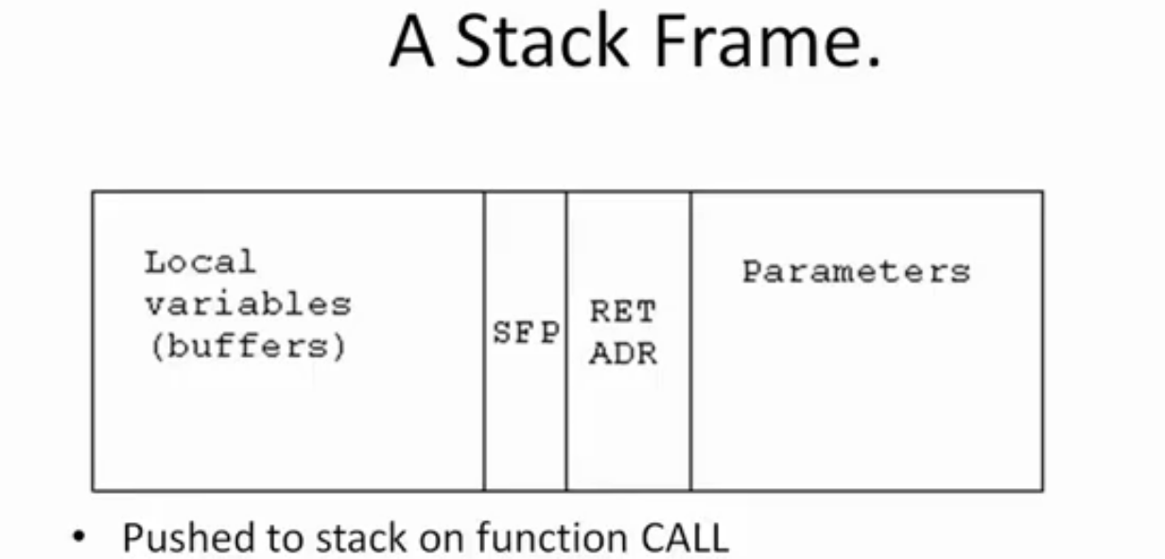
Stack Smashing
In any function call three components are always involved
Compiler
Application
Architecture
When a function is called, the stack frame is created.

Slide 95
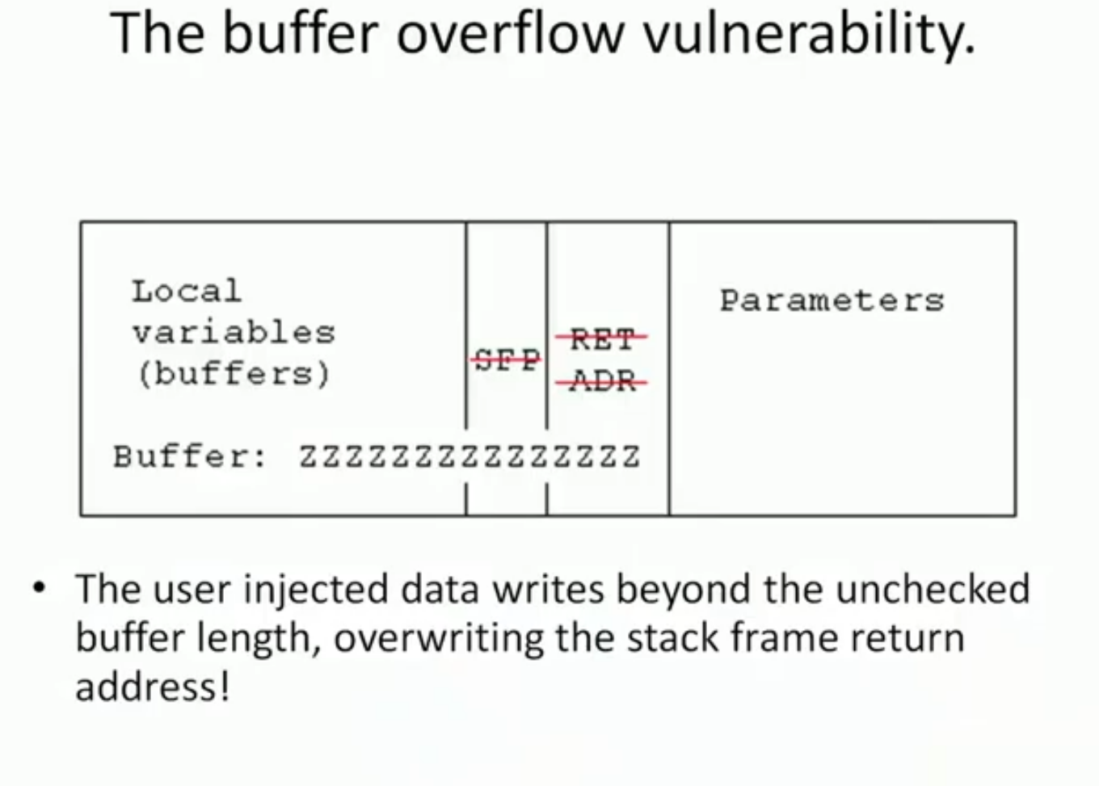

Slide 96
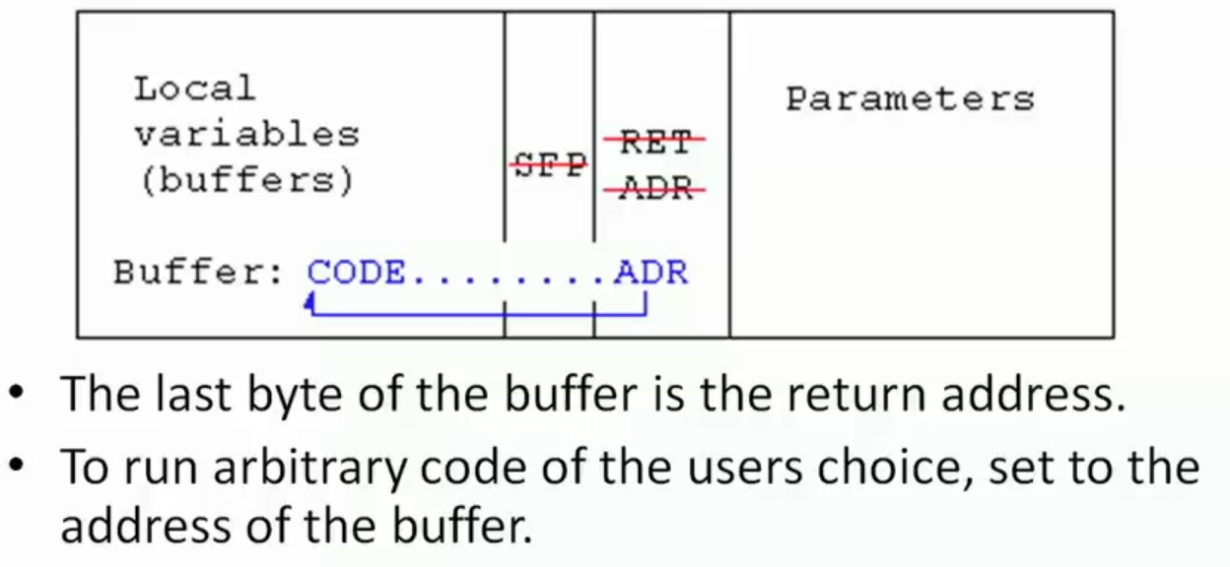
Assembly code in buffer

Slide 97
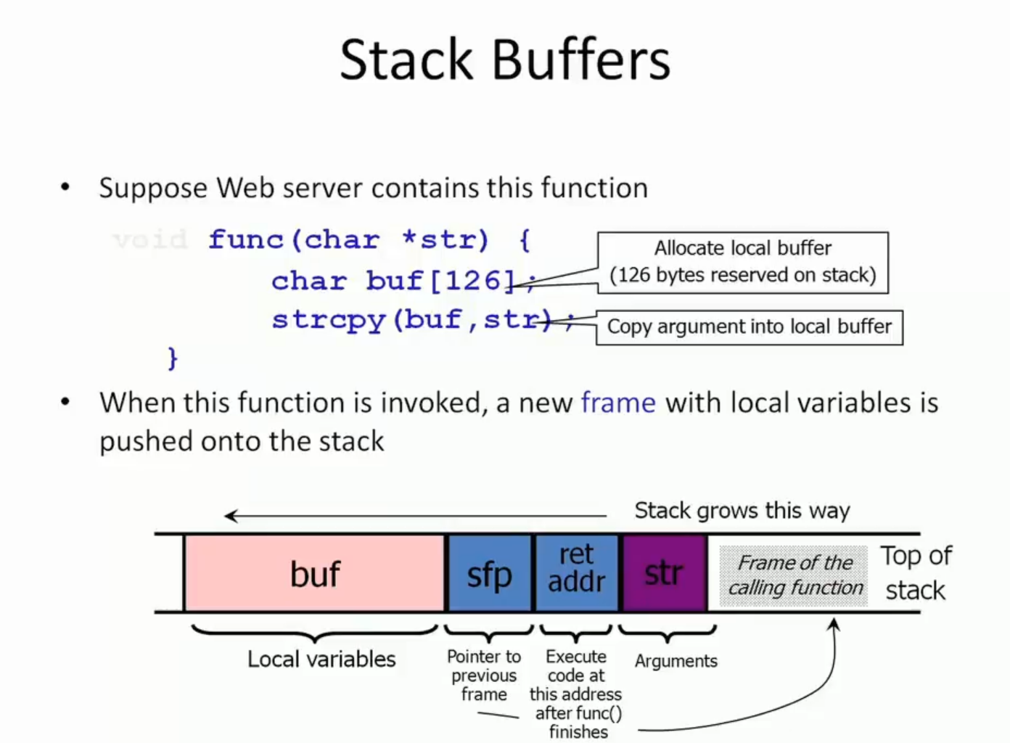

Slide 98
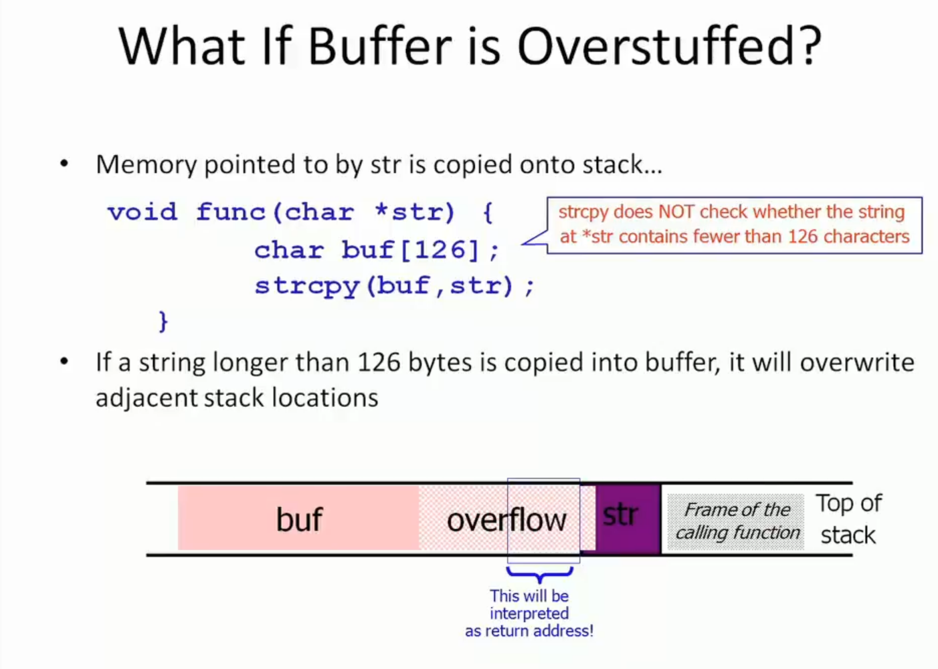

Slide 99
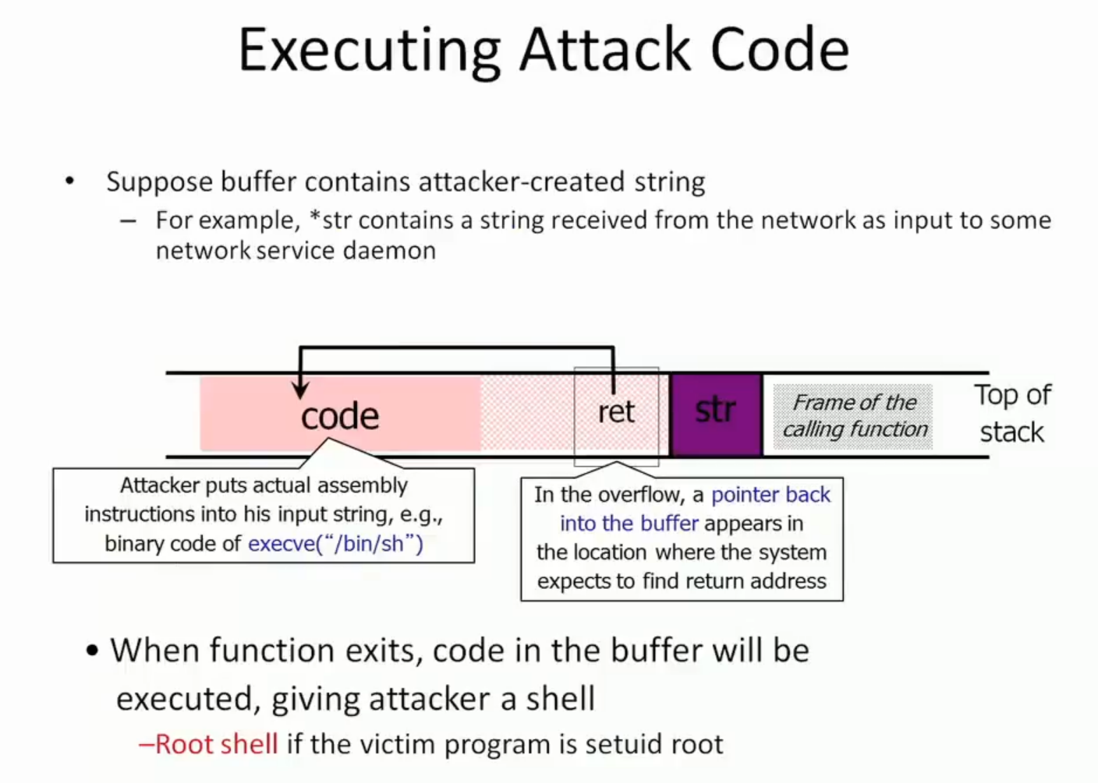

Slide 100
Data Types
Stack smashing
The lack of bounds checking on array subscripts and pointer arithmetic is a major source of bugs and security problems in C. Many of the most infamous Internet viruses have propagated by means of stack smashing, a particularly nasty form of buffer overflow attack.
Consider a (very naive) routine designed to read a number from an input stream:

Slide 101
Data Types
If the stream provides more than 100 characters without a newline ('\n'), those characters will overwrite memory beyond the confines of buf, as shown by the large white arrow in the figure.
A careful attacker may be able to invent a string whose bits include both a sequence of valid machine instructions and a replacement value for the subroutine’s return address. When the routine attempts to return, it will jump into the attacker’s instructions instead.
Stack smashing can be prevented by manually checking array bounds in C, or by configuring the hardware to prevent the execution of instructions in the stack

Slide 102
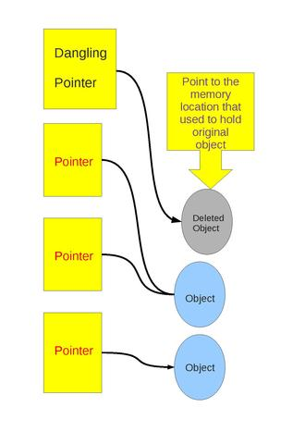
Danling Reference
A dangling reference is a reference to an object that no longer exists.
Garbage is an object that cannot be reached through a reference.
Dangling reference arise during object destruction, when an object that has an incoming reference is deleted or deallocated, without modifying the value of the pointer.
A dangling pointer is a pointer which points to same non-existing memory location.
For example
int main()
{
int * ptr = (int *)malloc(sizeof(int));
….
free(ptr);
return 0;
}
Here the pointer is till pointing to the deallocated memory

Slide 103
How to overcome this situation
int main()
{
int * ptr = (int *)malloc(sizeof(int));
….
free(ptr);
ptr=NULL; /* Now ptr is no more dangling */
return 0;
}
Tombstone is an alternative approach can be implemented in language systems that prevent the dangling pointer from accessing memory locations.

Slide 104
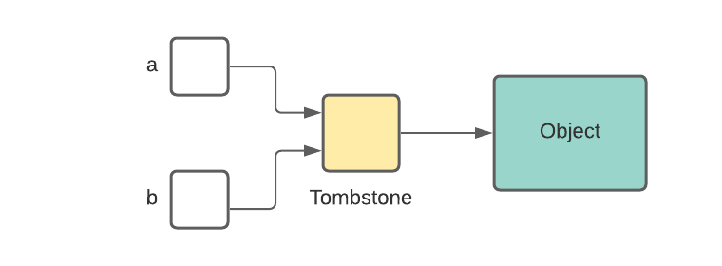
Tombstone
As soon as memory is allocated, it is assigned to a pointer called the tombstone.
As shown in the diagram, we would have to double dereference the pointers i.e. *(*a) or *(*b) to access the memory.

Slide 105
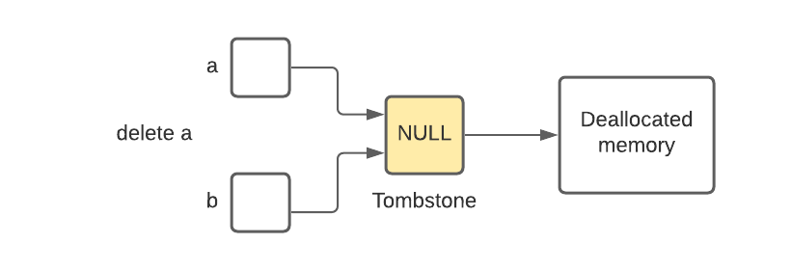
Tombstone
Now, the memory is deallocated using pointer a. Soon after deallocation, we assign a NULL value to the tombstone.
Now, if we try to access the memory using a or b, we get a NULL pointer dereference error i.e. *(*NULL) is an invalid operation.
This prevented the dangling pointers from accessing the memory location.

Slide 106
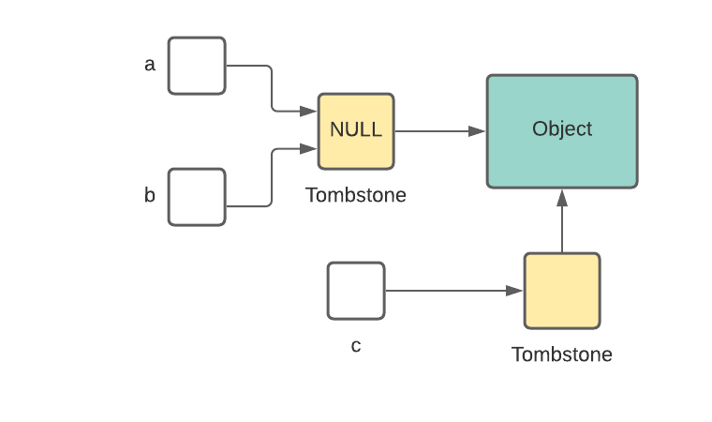
Tombstone
This method is quite taxing in terms of time and space.
The time to access memory is more as we are dereferencing two times.
Also, we cannot use the same tombstone if the deallocated memory is allocated again. We would have to make a new one.

Slide 107
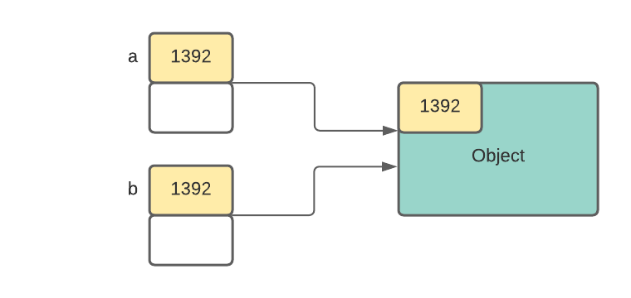
Lock and Keys
When memory is allocated, space for one more cell called the lock cell is allocated. This cell is assigned a value.
The pointer which points to this memory is stored as a tuple containing an address and a key.
A pointer is allowed to access the memory only if the values of the lock and keys match. Otherwise, it will throw a runtime error.

Slide 108
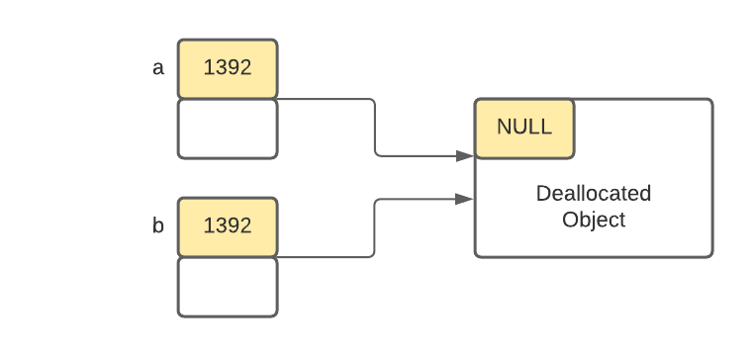
Lock and Keys
Now, the memory is deallocated using pointer a. Soon after deallocation, we assign a NULL value to the lock.
Now, if we try to access the memory using a or b, the values of the lock and the keys do not match and runtime error is thrown.
This prevented the dangling pointers from accessing the memory location.

Slide 109
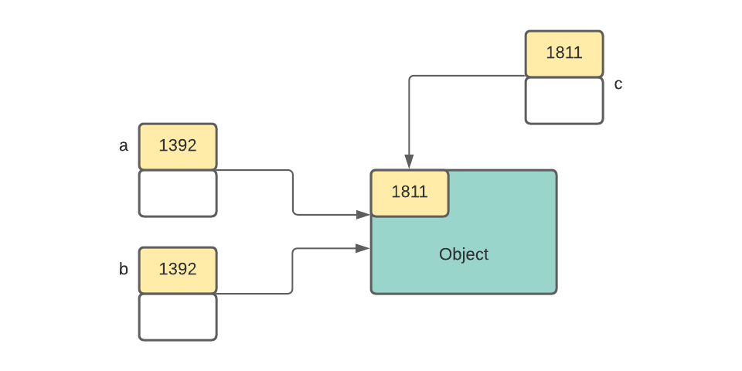
Lock and Keys
Also, we won’t need a new lock cell when the memory is re-allocated. We can simply change the value of the lock.
As the value of the lock was changed, pointers a and b cannot access it.
This method is time costly as on every pointer access, lock and key comparison is done. There’s a space overhead too. We have to allocate extra cells for storing the lock and key values.

Slide 110
Data Types
Tombstones/Lock and Key for Dangling Reference.
Tombstones introduce an extra level of indirection on every pointer access. When an object is reclaimed, the indirection word (tombstone) is marked in a way that invalidates future references to the object.
Locks and keys add a word to every pointer and to every object in the heap; these words must match for the pointer to be valid.
Tombstones can be used in languages that permit pointers to nonheap objects, but they introduce the secondary problem of reclaiming the tombstones themselves. Locks and keys are somewhat simpler, but they work only for objects in the heap.

